Slide 1
Digital Portfolio
STUDENT NAME: SAIRAJ M
NMID EDUNET: D8F6F87B33A86BAA2E842FBB1BF1C102
NMID:astvu31931924u18025
DEPARTMENT: B.SC (Computer Science)
PORTFOLIO LINK:
COLLEGE: COLLEGE/ UNIVERSITY: Mazharul uloom college/Thiruvalluvar university

Slide 2
PROJECT TITLE
“DESIGN AND DEVELOPMENT OF A DIGITAL PORTFOLIO WEBSITE”

Slide 3


AGENDA
Problem Statement
Project Overview
End Users
Tools and Technologies
Portfolio design and Layout
Features and Functionality
Results and Screenshots
Conclusion
Github Link
3/21/2024 Annual Review

Slide 4

PROBLEM STATEMENT

Slide 5

PROJECT OVERVIEW
This project is about creating a Digital Portfolio Website that represents my academic profile, skills, certifications, and projects in a professional way. The website is designed with HTML, CSS, and JavaScript to ensure a clean look, smooth navigation, and responsive design. It also includes features like a dark/light mode toggle, a typing text effect, and a contact section. The main goal of this portfolio is to act as an online resume and showcase my journey as a computer science student and developer

Slide 6

WHO ARE THE END USERS?
College Faculties – To evaluate the project work and academic performance.
Project Evaluators / Internal & External Examiners – To review technical implementation and presentation.
Students / Peers – To use as a reference or inspiration for creating their own portfolio.
Future Recruiters (Placement Cell use) – To see academic details, certifications, and skills of the student.

Slide 7

TOOLS AND TECHNIQUES
HTML5 – For creating the structure of the website.
CSS3 – For styling, layout, and responsive design.
JavaScript – For adding interactivity (typing effect, dark/light mode, smooth scrolling).
VS Code – As the code editor for development.
Git & GitHub – For version control and project hosting.

Slide 8
POTFOLIO DESIGN AND LAYOUT
Navigational bar: Quick links to all sections.
Profile Section: Photo, name & typing effect.
About: Academic profile & background.
Skills: Programming languages & tools.
Projects: Implemented works.
Certifications: Courses & achievements.
Contact: Phone & email.
Features: Dark/Light mode, Responsive design.
<number>

Slide 9
FEATURES AND FUNCTIONALITY
Dark/Light Mode Toggle – Switch between light and dark themes for better user experience.
Typing Text Effect – Dynamic introduction to highlight role and skills.
Smooth Scrolling Navigation – Easy movement between sections.
Responsive Design – Works on both mobile and desktop screens.
Interactive Contact Section – Quick access to email and phone.

Slide 10

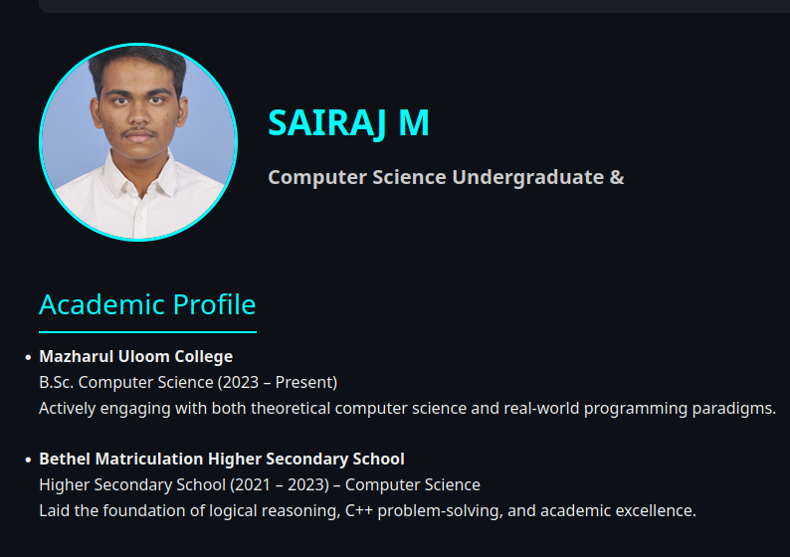
RESULTS AND SCREENSHOTS
Homepage / Profile Section
3/21/2024 Annual Review
<number>

Slide 11
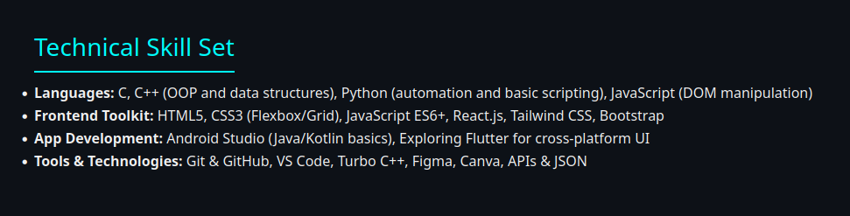
Skill Section

Slide 12
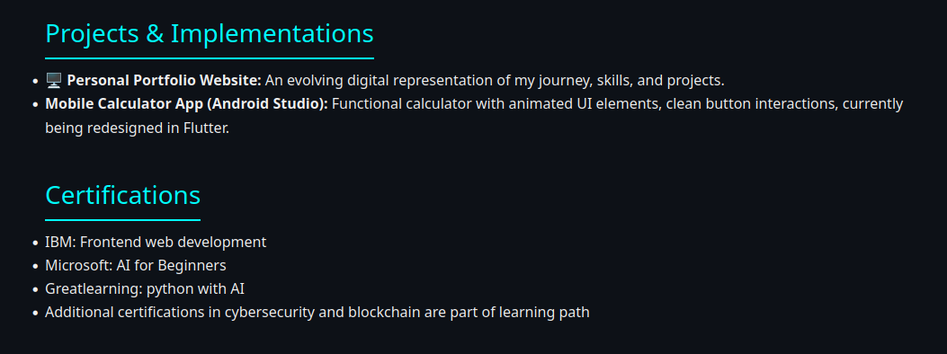
Project Section

Slide 13
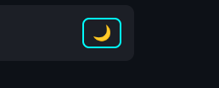
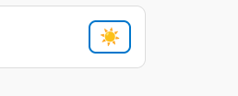
Dark/Light Mode View

Slide 14
CONCLUSION
This project helped me design and develop a Digital Portfolio Website to showcase my academic profile, skills, projects, and certifications in a professional way. It improved my knowledge of HTML, CSS, and JavaScript, and enhanced my frontend development skills. In the future, this portfolio can be expanded with backend features and hosted online for wider accessibility.
<number>

